Slide 1

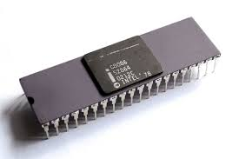
Programming with Intel 8086
18ECC203J: Module – 2
Faculty of Engineering and Technology, SRM Institute of Science and Technology
Organized by
Dr. K. A. Sunitha, Associate Professor, EIE, SRMIST
Dr. B. Ramakrishna, Assistant Professor, ECE, SRMIST
Picture Courtesy :Google

Slide 2
Session - 11
Assembly Language Programming of 8086

Slide 3
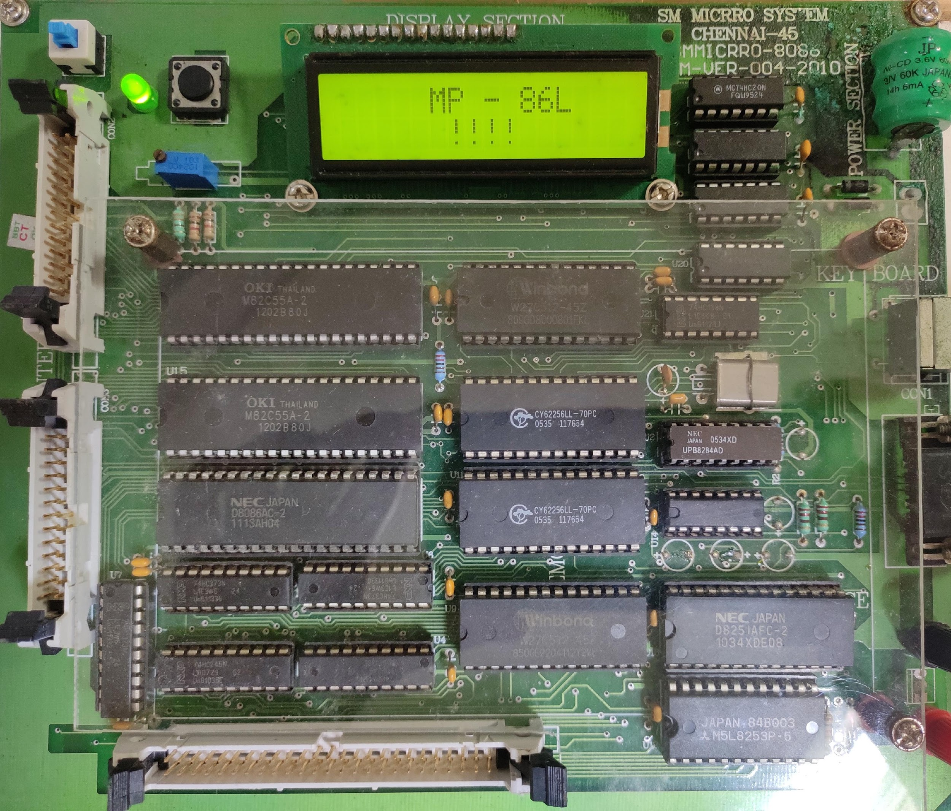
How does our Microprocessor Based System looks like..?
Working Model from Laboratory
Note: Information Provided in the next slides is subjected with © Oxford University Press 2013

Slide 4
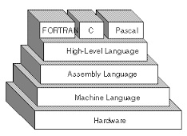
Review of Basics-Layers of Programming
Machine Language
Binary
Hexadecimal
Machine code or object code
Assembly Language
Mnemonics
Assembler
High-Level Language
Pascal, Basic, C
Compiler
Picture Courtesy :Google

Slide 5
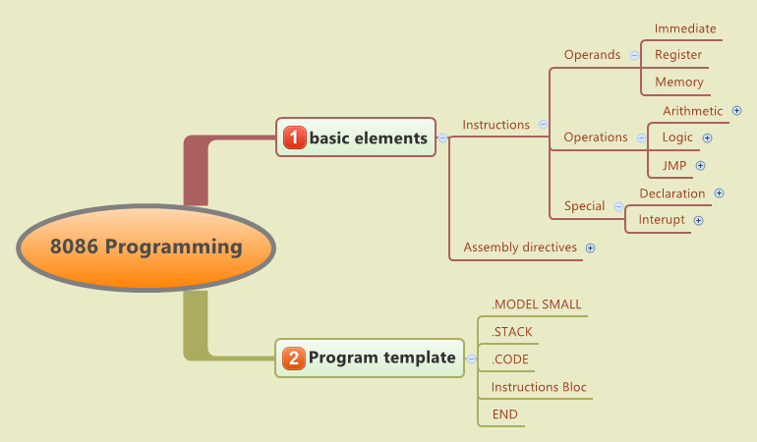
Program Structure
Picture Courtesy :Google

Slide 6
8086 Assembly Language Programming
A few assembly language programming examples similar to the assembly language programming of 8085 are given in this section.
These programs can be converted into machine language programs and executed in the 8086 based system either manually finding the opcode for each instruction or by using assembler. As finding the opcode of each instruction of 8086 manually is time consuming, line assembler or assembler is normally used.
The line assembler converts each mnemonics of an instruction immediately into opcode as it is entered in the system and this type of assembler is used in microprocessor trainer kits. Line assembler is stored in any one of ROM type memory in the trainer kit.
The assembler needs a personal computer for generating the opcodes of an assembly language program and the generated opcodes can be downloaded to the microprocessor based system such as microprocessor trainer kit or microprocessor based prototype hardware through serial port or parallel port of the computer.

Slide 7
8086 Assembly Language Programming
There are many assemblers like MASM (Microsoft Macro Assembler), TASM (Turbo Assembler) and DOS Assembler which are used to convert the 8086 assembly language program into machine language program.
While using these assemblers, the assembly language program is written using assembler directives. Assembler directives are commands to the assembler to indicate the size of a variable (either byte or word), number of bytes or words to be reserved in memory, value of a constant and name of a segment, etc. in a program.
The assembler directives are not converted directly into opcode but they are used to generate proper opcode of an instruction. The use of Microsoft assembler alone is discussed in the second part of this section.

Slide 8
Writing 8086 program using line assembler
Write a program to add a word type data located at offset 0800H (Least Significant Byte) and 0801H (Most Significant Byte) in the segment address 3000H to another word type data located at offset 0700H (Least Significant Byte) and 0701H (Most Significant Byte) in the same segment. Store the result at offset 0900H and 0901H in the same segment. Store the carry generated in the above addition in the same segment at offset 0902H.
MOV AX, 3000H
MOV DS, AX ; initialize DS with value 3000H
MOV AX, [800H] ; get first data word in AX
ADD AX, [700H] ; add AX with second data word
MOV [900H], AX ; store AX at the offset 900H & 901H
JC CARRY ; if carry=1, go to the place CARRY
MOV [902H], 00H ; no carry; hence store 00H at the offset 902H
JMP END ; go to the place END
CARRY: MOV [902H], 01H ; store 01H at the offset 902H
END: HLT ; stop

Slide 9
Writing 8086 Program Using Line Assembler
Write a program to find the smallest word in an array of 100 words stored sequentially in the memory starting from the offset 1000H in the segment address 5000H and store the result at the offset 2000H in the same segment.
MOV CX, 99 ; initialize CX with the number of comparisons (=100-1)
MOV AX, 5000H
MOV DS, AX ; initialize DS with the segment address 5000H
MOV SI, 1000H ; initialize SI with offset 1000H
MOV AX, [SI] ; get the first word in AX
START: INC SI
INC SI ; increment SI twice to point the next word
CMP AX, [SI] ; compare next word with the word in AX
JC REPEAT ; if AX is smaller then go to REPEAT
MOV AX, [SI] ; replace the word in AX with the smaller word
REPEAT: LOOP START ; repeat the operation from START
MOV [2000H], AX ; store smallest number in AX at the offset 2000H
HLT ; stop

Slide 10
Programs: Sorting in Ascending and Descending Order
 | MOV SI,1200h
 | MOV CL,[SI]
 | DEC CL
LOOP3 | MOV SI,1200h
 | MOV CH,[SI]
 | DEC CH
 | INC SI
LOOP2 | MOV AL,[SI]
 | INC SI
 | CMP AL,[SI]
 | JC LOOP1
 | XCHG AL,[SI]
 | XCHG [SI-1],AL
LOOP1 | DEC CH
 | JNZ LOOP2
 | DEC CL
 | JNZ LOOP3
 | HLT
 | MOV SI,1200h
 | MOV CL,[SI]
 | DEC CL
LOOP3 | MOV SI,1200h
 | MOV CH,[SI]
 | DEC CH
 | INC SI
LOOP2 | MOV AL,[SI]
 | INC SI
 | CMP AL,[SI]
 | JNC LOOP1
 | XCHG AL,[SI]
 | XCHG [SI-1],AL
LOOP1 | DEC CH
 | JNZ LOOP2
 | DEC CL
 | JNZ LOOP3
 | HLT

Slide 11

@Students :You may Try to with these Programs….
Write an ALP to add first 10 odd numbers and store in the memory location 1234H
Write an ALP to generate first 10 Fibonacci numbers and store in 1300H series.

Slide 12
Introducing 8086 Assembler Directives
An assembler is a program used to convert an assembly language program into equivalent machine language program. The assembler finds the address of each label and substitutes the value for each of the constants and variables in the assembly language program during the assembly process, to generate the machine language code.
While doing these things, the assembler may find out syntax errors and it is reported to programmer at the end of assembly process. The logical errors or other programming errors are not found by the assembler.
For completing all the above tasks, an assembler needs some commands from the programmer namely the required storage class for a particular constant or a variable such as byte, word or double word, logical name of the segments such as CODE or STACK or DATA segment, type of different procedures or routines such as FAR or NEAR or PUBLIC or EXTRN and end of a segment, etc.
These types of commands are given to the assembler using some predefined alphabetical strings called assembler directives which help the assembler to correctly generate the machine codes for the assembly language program.

Slide 13
Assembler directives related to code (i.e. program) location
A) ORG: (WHY WE ARE USING ORG 100h in Emulator)
The ORG (origin) directive directs the assembler to start the memory allocation for a particular segment (data or code or stack) from the declared address in the ORG statement. While starting the assembly process for a memory segment, the assembler initializes a location counter (LC) to keep track of the allotted offset addresses for the segment. When ORG directive is not mentioned at the beginning of the segment, then LC is initialized with the offset address 0000H. When ORG directive is mentioned at the beginning of the segment, then LC is initialized with the offset address specified in the ORG directive.
Example: ORG 100H
When the above directive is placed at the beginning of code segment, then the location counter is initialized with 0100H and the first instruction is stored from the offset address 0100H within the code segment. If it is placed in data segment then the next data storage will start from the offset address 0100H within the data segment. “You may explore Other Assembler Directives to extend your knowledge”

Slide 14
MACRO
Defining a MACRO:
A MACRO can be defined anywhere in a program using the directives MACRO and ENDM. The label prior to the MACRO is the macro name which is used in the main program wherever needed. The ENDM directive marks the end of the instructions or statements assigned with the macro name.
Example:
CALCULATE MACRO
MOV AX, [BX]
ADD AX, [BX+2]
MOV [SI], AX
ENDM

Slide 15
Passing parameters to a MACRO:
Using parameters in a macro definition, the programmer specifies the parameters of the macro those are likely to be changed each time the macro is called. The above macro (CALCULATE) can be modified to calculate the result for different sets of data and store it in different memory locations as given below:
CALCULATE MACRO OPERAND, RESULT
MOV BX, OFFSET OPERAND
MOV AX, [BX]
ADD AX, [BX+2]
MOV SI, OFFSET RESULT
MOV [SI], AX
ENDM
The parameters OPERAND and RESULT can be replaced by OPERAND1, RESULT1 and OPERAND2, RESULT2 while calling the above macro as shown below: ………………………..
CALCULATE OPERAND1, RESULT1
……………………….
………………………
CALCULATE OPERAND2, RESULT2
……………………….

Slide 16
Writing Assembly Language Programs While Using MASM
MASM (Microsoft Macro Assembler) is one of the assemblers commonly used along with a LINK (linker) program to structure the machine codes generated by MASM in the form of an executable (EXE) file. The MASM reads the assembly language program, which is known as source program and produces an object file as output
The LINK program accepts the object file produced by MASM along with library files if needed, and produces an EXE file.
While writing a program for MASM, first the program listing is typed using a text editor in the computer such as Norton’s Editor (NE), Turbo C editor, etc. After the program editing is done, it is saved under a name with an extension .ASM, for example MSI.ASM is a valid file name which can be assigned for an assembly language program.
The programmers have to ensure that all the files namely the editor, MASM.EXE (MASM assembler) and LINK.EXE (linker) are available in the same directory. After editing, assembling of the program has to be done using MASM.

Slide 17
Writing Assembly Language Programs While Using MASM
If all the above software are present in root directory of C drive in the computer, then to assemble the file name MSI.ASM, the programmer has to type the following at the DOS prompt in the computer:
C:\ > MASM MSI.ASM
(or)
C:\ > MASM MSI
After entering the above command, the assembler asks for giving the name of the following files, which it will generate after assembly process as given below:
Object file name [.OBJ]:
List file name [NUL.LST]:
Cross reference [NUL.CRF]:

Slide 18
Writing Assembly language programs while using MASM
The programmer can type a name against every file name and then press ‘enter’ key after giving each name. If no name is entered against each file name before pressing the enter key in all cases then all the above three files will have the same name as the source file.
The .OBJ (object) file contains the machine codes of the program which is assembled. The .LST (list) file contains the total offset map of the source file including labels, opcodes, offset addresses, memory allotment for different labels and directives.
The cross reference (.CRF) file is used for debugging the source program as it contains the information such as size of the file in bytes, list of labels, number of labels and routines to be called, etc. in the source program.
After the cross reference file name is entered, the assembly process starts. If the program contains syntax errors, they are displayed using error code number and the corresponding line numbers at which they appear. Once these errors are corrected by the programmer, the assembly process will be completed successfully.

Slide 19
Writing Assembly Language Programs While Using MASM
The DOS linking program LINK.EXE is used to link the different object modules of a source program and the function library routines to produce an integrated executable code for the source program. The linker is invoked using the following command:
C:\> LINK MSI.OBJ
After entering the above command, the linker asks for giving the name of the following files: Run file [.EXE]:
List files [NUL.MAP]:
Libraries [LIB]:
If no file names are entered for these files, then by default, the source file name is considered with different extensions. The option input ‘Libraries’ expects any special library name from which the functions were used by the source program. The output of the linker program is an executable file with the entered or default file name with .EXE extension. The executable file name can be entered at the DOS prompt to execute the file as shown below:
C:\> MSI.EXE

Slide 20
Writing Assembly Language Programs While Using MASM
In the advanced version of MASM, both assembling and linking is combined under a single menu invokable compile function.
The DEBUG.com is a DOS utility program that is used for debugging and trouble –shooting 8086 assembly language programs.
The DEBUG utility enables us to have the control of the processor resources and memory in the computer (PC) which uses one of the INTEL processor as the CPU up to some extent as most of them run under the control of operating system.
The DEBUG enables us to use the PC as a low-level 8086 microprocessor kit. By typing the DEBUG command at DOS prompt and pressing enter key invokes the debugging facility. A ‘-‘(dash) appears after the successful invoke operation of DEBUG as shown below:
C:\> DEBUG

Slide 21
Writing Assembly Language Programs While Using MASM
Now by typing ‘R’ at the ‘-’ line and pressing enter key, we can see the content of different registers and flags present in the CPU of the PC as shown below:
-R
AX=0000H BX=0005H CX=000DH DX=S000H SP=8500H BP=9800H SI=2000H DI=7000H
DS=S000H ES=3000H SS=4000H CS=2000H
IP = 2000H FLAGS= 0024H
The remaining DEBUG commands can be seen in any book which discusses assembly language programming in personal computer (PC). In the following section, few examples for writing 8086 assembly language program while using assembler are given.

Slide 22
Write a program to add two 8-bit data (F0H and 50H) in 8086 and to store result in memory, when assembler is used
. ASSUME CS: CODE, DS: DATA
DATA SEGMENT ; Beginning of data segment
OPER1 DB F0H ; First operand
OPER2 DB 50H ; Second operand
RESULT DB 01 DUP (?) ; A byte of memory is reserved for result
CARRY DB 01 DUP (?) ; A byte is reserved for storing carry
DATA ENDS ; End of data segment
CODE SEGMENT ; Beginning of code dement
START: MOV AX, DATA ; Initialize AX with the segment address of DS
MOV DS, AX ; Move AX content to DS
MOV BX, OFFSET OPER1 ; Move the offset address of OPER1 to BX
MOV AL, [BX] ; Move first operand to AL
ADD AL, [BX+1] ; Add second operand to AL
MOV SI, OFFSET RESULT ; Store offset address of RESULT in SI
Contd….

Slide 23
MOV [SI], AL ; Store content of AL in the location RESULT
INC SI ; Increment SI to point location of carry
JC CAR ; If carry =1, go to the place CAR
MOV [SI], 00H ; Store 00H in the location CARRY
JMP LOC1 ; go to the place LOC1
CAR: MOV [SI], 01H ; Store 01H in the location CARRY
LOC1: MOV AH, 4CH
INT 2IH ; Return to DOS prompt
CODE ENDS ; End of code segment
END START ; Program ends
In the above program, the instructions MOV AH, 4CH and INT 2IH at the end of the program are used for returning to the DOS prompt after executing the program in the computer. If instead of these two instructions, if one writes HLT instruction, the computer will hang after executing the program as the CPU goes to halt state and the user will not be able to examine the result.

Slide 24
Session – 12
Stack structure and related programming

Slide 25
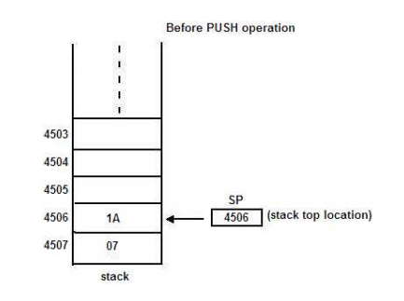
Stack Structure
Picture Courtesy :Google
Stack is a set of memory locations in the Read/Write memory which is used for temporary storage of binary information during the execution of a program.
It is implemented in the Last-in-first-out (LIFO) manner. i.e., the data written first can be accessed last, One can put the data on the top of the stack by a special operation known as PUSH.
Data can be read or taken out from the top of the stack by another special instruction known as POP.

Slide 26
Stack Structure
Stack is implemented in two ways. In the first case, a set of registers is arranged in a shift register organization.
One can PUSH or POP data from the top register. The whole block of data moves up or down as a result of push and pop operations respectively.
In the second case, a block of RAM area is allocated to the stack. A special purpose register known as stack pointer (SP) points to the top of the stack.
Whenever the stack is empty, it points to the bottom address. If a PUSH operation is performed, the data are stored at the location pointed to by SP and it is decremented by one. Similarly if the POP operation is performed, the data are taken out of the location pointed at by SP and SP is incremented by one. In this case the data do not move but SP is incremented or decremented as a result of push or pop operations respectively

Slide 27
Stack Structure
Application of Stack: Stack provides a powerful data structure which has applications in many situations. The main advantage of the stack is that, We can store data (PUSH) in it with out destroying previously stored data.
This is not true in the case of other registers and memory locations. stack operations are also very fast The stack may also be used for storing local variables of subroutine and for the transfer of parameter addresses to a subroutine.
This facilitates the implementation of re-entrant subroutines which is a very important software property. The disadvantage is, as the stack has no fixed address, it is difficult to debug and document a program that uses stack.

Slide 28
Stack Operation
Stack operation: Operations on stack are performed using the two instructions namely PUSH and POP. The contents of the stack are moved to certain memory locations after PUSH instruction.
Similarly, the contents of the memory are transferred back to registers by POP instruction.

Slide 29
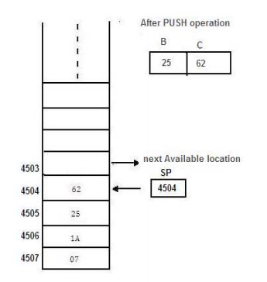
The PUSH operation of the Stack
Let us consider two registers (register pair) B & C whose contents are 25 & 62.
Picture Courtesy :Google

Slide 30
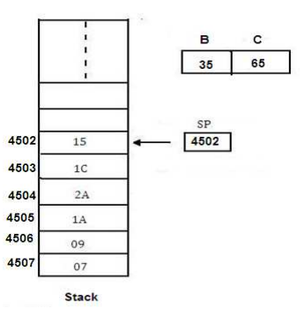
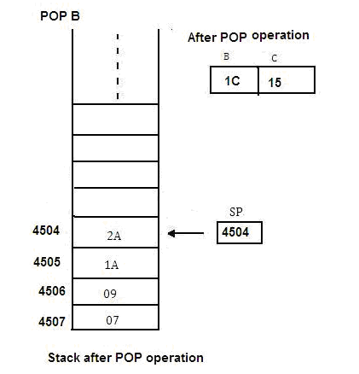
The POP operation of the Stack
Picture Courtesy :Google

Slide 31
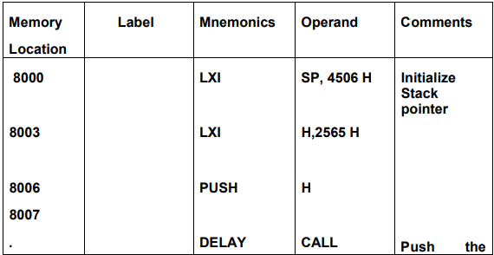
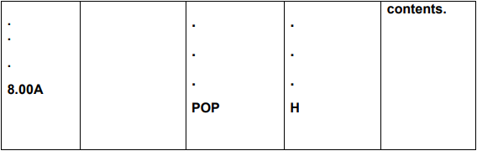
Example program
Write a program to initialize the stack pointer (SP) and store the contents of the register pair HL on stack by using PUSH instruction. Use the contents of the register pair for delay counter and at the end of the delay retrieve the contents of H-L using POP.
Picture Courtesy :Google

Slide 32
Session – 13
Interrupt Structure and related programming

Slide 33
Interrupts
The meaning of ‘interrupts’ is to break the sequence of operation
While the CPU is executing a program, an interrupt breaks the normal sequence of execution of instructions, diverts its execution to some other program called Interrupt Service Routine (ISR)
After executing ISR , the control is transferred back again to the main program 8086 Interrupts and Interrupt Response

Slide 34
Types of Interrupt
An 8086 interrupt can come from any one of the three sources
One source is an external signal applied to the Non Maskable Interrupt (NMI) input pin or to the Interrupt (INTR) input pin
An interrupt caused by a signal applied to one of these inputs is referred to as a hardware interrupt
A second source of an interrupt is execution of the Interrupt instruction, INT, This is referred to as Software Interrupt
The third source of an interrupt is some error condition produced in the 8086 by the execution of an instruction
An example of this is the divide by zero error

Slide 35
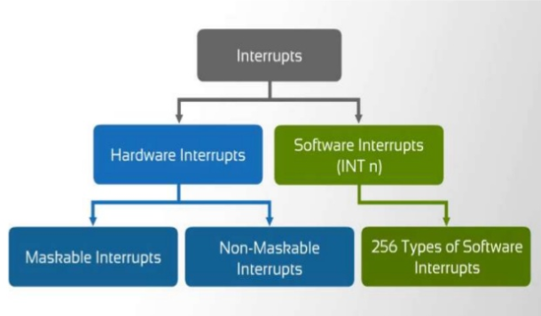
Types of Interrupt
Picture Courtesy :Google

Slide 36
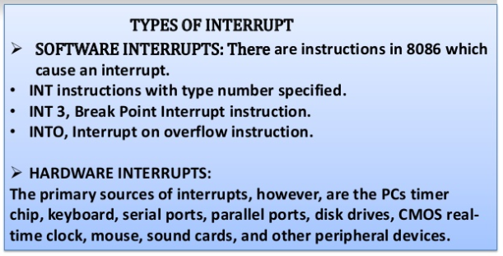
Types of Interrupt
Picture Courtesy :Google

Slide 37
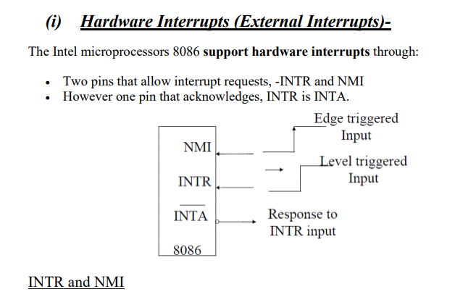
Hardware Interrupt
Picture Courtesy :Google

Slide 38
Software Interrupts
The interrupt vector table contains 256 four byte entries, contains the CS:IP
Interrupt vectors for each of the 256 possible interrupts. The table is used to locate the interrupt service routine addresses for each of those interrupts.
The Interrupt vector table is located in the first 1024 bytes of memory at addresses 000000H-0003FFH.It contains the address(segment and offset)of the interrupt service provider

Slide 39
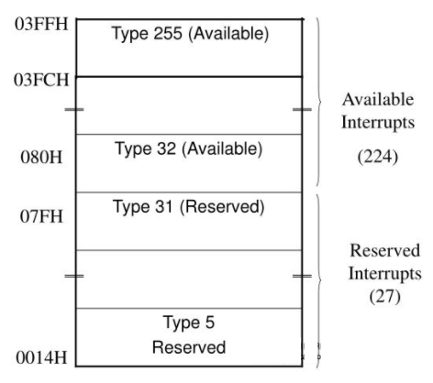
Software Interrupts
The first five interrupt vectors are identical in all Intel processors
Intel reserves the first 32 interrupt vectors
The last 224 vectors are user available
Each is four bytes long in real mode and contains the starting address of the interrupt service procedure.
The first two bytes contain the offset address The last two contain the segment address
Picture Courtesy :Google

Slide 40
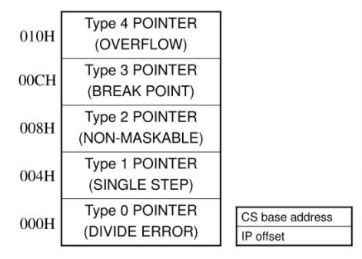
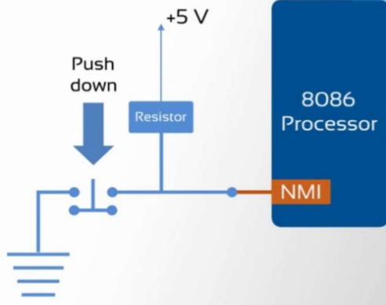
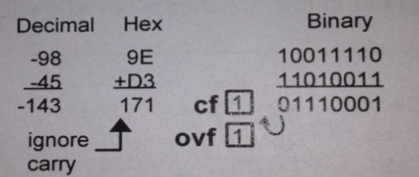
Types of Interrupts
TYPE 0 The divide error : whenever the results from a division overflows or an attempt is made to divide by zero.
Type 2 The non-maskable interrupt occurs when a logic 1 is placed on the NMI input pin to the microprocessor. non- maskable—it cannot be disabled
Type 3 A special one-byte instruction (INT 3) that uses this vector to access its interrupt-service procedure. often used to store a breakpoint in a program for debugging
TYPE 4 Overflow is a special vector used with the INTO instruction. The INTO instruction interrupts the program if an overflow condition exists.
TYPE 2
TYPE 4
Picture Courtesy :Google

Slide 41
Types of Interrupts
TYPE 5 The BOUND instruction compares a register with boundaries stored in the memory. If the contents of the register are greater than or equal to the first word in memory and less than or equal to the second word, no interrupt occurs because the contents of the register are within bounds. if the contents of the register are out of bounds, a type 5 interrupt ensues as reflected by the overflow flag (OF)
Type 7 The coprocessor not available interrupt occurs when a coprocessor is not found, as dictated by the machine status word (MSW or CR0) coprocessor control bits. if an ESC or WAIT instruction executes and no coprocessor is found, a type 7 exception or interrupt occurs

Slide 42
Types of Interrupts
Type 8 A double fault interrupt is activated when two separate interrupts occur during the same instruction.
In computing, a double fault is a serious type of error that occurs when a central processing unit (CPU) cannot adequately handle a certain type of system event that requires the CPU’s immediate attention. Double faults may cause computer crashes and error messages, automatic restarting of the machine, and the loss of any unsaved data. They are often caused by problems in the computer’s hardware such as a bad memory module or overheating CPU.

Slide 43
Types of Interrupts
Type 9 The coprocessor segment overrun occurs if the ESC instruction (coprocessor opcode) memory operand extends beyond offset address FFFFH in real mode.
Type 10 An invalid task state segment interrupt occurs in the protected mode if the TSS is invalid because the segment limit field is not 002BH or higher. usually because the TSS is not initialized
Type 11 The segment not present interrupt occurs when the protected mode P bit (P = 0) in a descriptor indicates that the segment is not present or not valid.

Slide 44
Types of Interrupts
Type 12 A stack segment overrun occurs if the stack segment is not present (P = 0) in the protected mode or if the limit of the stack segment is exceeded.
Type 13 The general protection fault occurs for most protection violations in 80286–Core2 in protected mode system. These errors occur in Windows as general protection faults. A list of these protection violations follows.

Slide 45
Types of Interrupts
Type 13 PROTECTION VIOLATIONS
(a) Descriptor table limit exceeded
(b) Privilege rules violated
(c) Invalid descriptor segment type loaded
(d) Write to code segment that is protected
(e) Read from execute-only code segment
(f) Write to read-only data segment
(g) Segment limit exceeded
(h) CPL = IOPL when executing CTS, HLT, LGDT, LIDT, LLDT, LMSW, or LTR o (i) CPL > IOPL when executing CLI, IN, INS, LOCK, OUT, OUTS, and STI (cont.)

Slide 46
Types of Interrupts
Type 14 Page fault interrupts occur for any page fault memory or code access in 80386, 80486, and Pentium–Core2 processors. Type 16 Coprocessor error takes effect when a coprocessor error (ERROR = 0) occurs for ESCape or WAIT instructions for 80386, 80486, and Pentium–Core2 only.
Type 17 Alignment checks indicate word and double word data are addressed at an odd memory location (or incorrect location, in the case of a double word). interrupt is active in 80486 and Pentium–Core2
Type 18 A machine check activates a system memory management mode interrupt in Pentium– Core2.

Slide 47
Summary
The addressing modes in 8086 are classified into Register, Immediate, Data memory, Stack memory and program memory addressing modes.
The different instructions in 8086 are classified into Data Transfer, Arithmetic, Logical, Shift, Rotate, Flag manipulation, Control Transfer, String and Machine Control instructions.
The assembly language programming of 8086 can be done with line assembler or assembler.
Assembler directives are used while writing assembly language program of 8086 which is to be assembled by using an assembler.

Slide 48
Key terms in Module
Addressing mode is the way by which the microprocessor addresses the operands while fetching data during execution of an instruction or the way by which the microprocessor calculates the memory address, from where the next instruction to be executed is taken, in the case of jump or call instructions.
Instruction set of 8086 consists of Data Transfer, Arithmetic, Logical, Shift, Rotate, Flag manipulation, Control Transfer, String and Machine Control Instructions.
Assembler is software which is used to convert assembly language program into machine language program.
Line assembler converts each line in assembly language program into corresponding machine language program immediately as it is entered in the system.
Assembler directives are commands to the assembler to give various details in a program such as the required storage class for a particular constant or a variable (byte, word or double word), logical name of the segments (CODE or STACK or DATA segment), type of different procedures or routines (FAR or NEAR or PUBLIC or EXTRN), end of a segment (ENDS) and defining a macro (MACRO, ENDM), etc.

Slide 49
Learning Resources
K. M. Bhurchandi and A. K. Ray, Advanced Microprocessors and Peripherals-with ARM and an Introduction to Microcontrollers and Interfacing, 3rd edition, Tata McGraw Hill, 2015.
Yu-cheng Liu, Glenn A. Gibson, Microcomputer systems: The 8086/8088 family-Architecture, programming and design, 2nd edition, Prentice Hall of India, 2007.

Slide 50
Thank You

